Slide 1
Chapter Ten
Inheritance, type checking

Slide 2
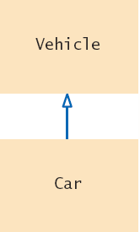
Inheritance Hierarchy
In object-oriented programming, inheritance is a relationship between:
A superclass or parent class: a more generalized class
A subclass or child class: a more specialized class
The subclass ‘inherits’ data (variables) and behavior (methods) from the superclass.
This means the subclass is a type of the superclass and have features of the superclass, much like how a human child inherits features of the parents.
Inheritance is another way of re-using code. The subclass doesn’t have to define data and implement methods of the superclass. It can just use them as its own data and methods.
superclass
subclass

Slide 3
A Vehicle Class Hierarchy
General
Specialized
Even more specialized

Slide 4
The Substitution Principle
The subclass is a type of the superclass: Car “is-a” Vehicle.
Car shares common traits with Vehicle.
We can substitute a Car object in an algorithm that expects a Vehicle object.
myVehicle = Vehicle(. . .)
printVehicle(myVehicle) # works with Vehicle
myCar = Car(. . .)
printVehicle(myCar) # therefore works with Car
The ‘is-a’ relationship is represented by an arrow in a class diagram.
It means that an object of the subclass can behave as an object of the superclass.
But the reverse is not true: a superclass object does not have all the characteristics of the subclass object.
is-a

Slide 5
Using Inheritance
Be careful not to overuse inheritance:
Use one class for differences in data values
Use inheritance (two classes) for differences in behavior
If two cars have different fuel efficiency (data), then the variation can be stored in an instance variable called MPG (miles per gallon).
Each of the two cars can be an object of the Car class, and each can store a different MPG value.
On the other hand, if one car has all-wheel-drive capability and the other does not (difference in behavior), then we use inheritance.
The car with all-wheel-drive is an object of the SUV class, and the car without all-wheel-drive is an object of the Sedan class.
Both cars still share the same data and behavior of the Car class, but they also differ in how they are driven.

Slide 6
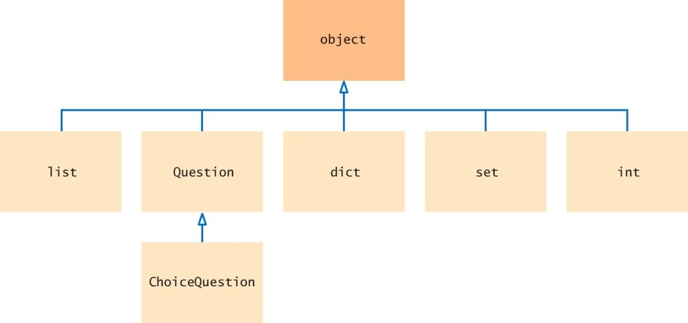
The Root Superclass: object
In Python, all data types are classes.
All classes, including user-defined classes, are automatically subclasses of the root superclass called object.
Built-in classes
User-defined classes

Slide 7
Defining a Subclass

Slide 8
Planning the Superclass and Subclasses
When we have several classes that share common instance variables and methods, we don’t have to repeat these same instance variables and methods over and over in all the classes.
Instead we create an inheritance hierarchy:
Move all common instance variables and methods into the superclass.
The instance variables and methods that are left are unique to each subclass.
Example: we have several types of quiz questions.
Each type share 4 common methods:
Set the text for the question
Set the text for the answer
Display the text of the question
Check for correct answer
We create a Question superclass with these common methods.
The specific types of questions can be subclasses.

Slide 9
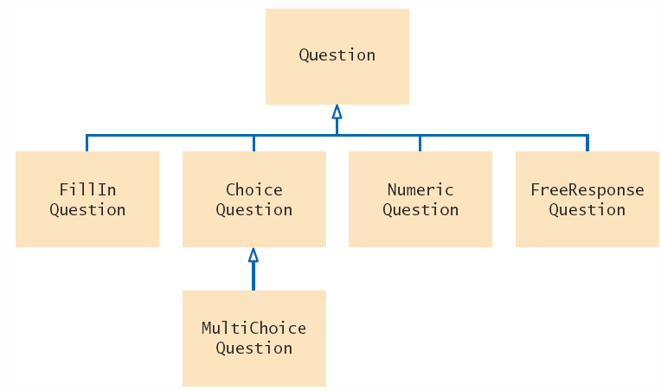
Example: Quiz Question Hierarchy
The inheritance hierarchy diagram
Question is the superclass
FillInQuestion, ChoiceQuestion, NumericQuestion, and FreeResponseQuestion are the subclasses.

Slide 10
Example: Question Superclass (1)
The Question class definition
class Question :
""" implement a quiz question and answer """
def _ _init_ _(self) :
""" create a question and answer string """
self._text = ""
self._answer = ""
def setText(self, questionText):
""" set question to input text """
self._text = questionText
def setAnswer(self, correctResponse):
""" set answer to correct answer """
self._answer = correctResponse
# continue on next slide...

Slide 11
Example: Question Superclass (2)
Continue with the Question class definition
class Question :
# ...continue from previous slide
def checkAnswer(self, response):
""" return True if response is correct answer """
return self._answer == response
def display(self) :
""" display question """
print(self._text)

Slide 12
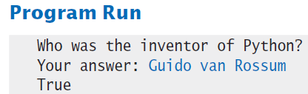
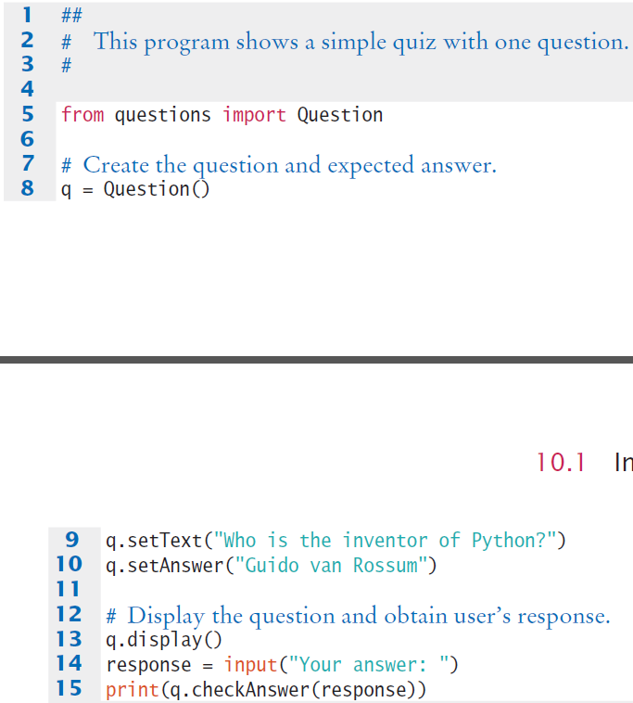
Example: Question Class Test Run

Slide 13
Inheriting from the Superclass
A subclass automatically inherits from the superclass:
All instance attributes
All instance methods
This inheritance causes the subclass to have all characteristics and behavior of the superclass.
In addition, the subclass can be a specialized type of the superclass by:
Adding new instance attributes that are specific to the subclass
Adding new methods that are specific to the subclass
Overriding the inherited methods by changing the implementation or providing a new implementation.

Slide 14
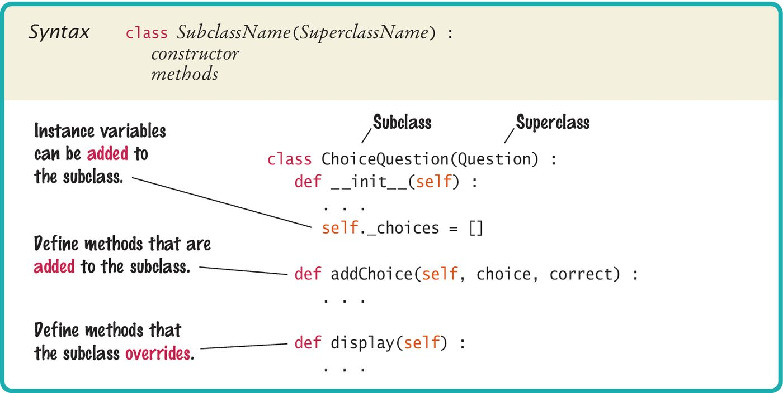
Defining a Subclass
The header of the class definition contains the superclass name inside parentheses.

Slide 15
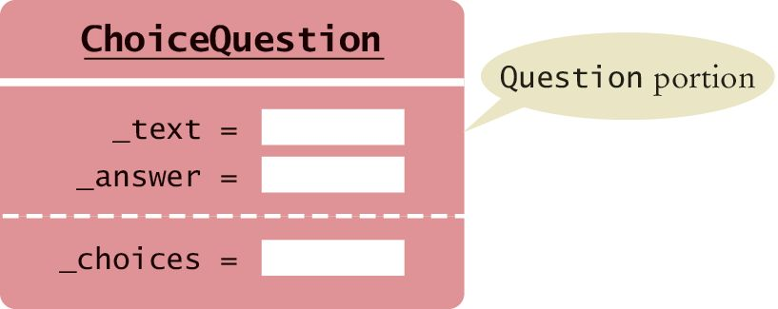
Attributes of the Subclass
From the previous slide, the ChoiceQuestion subclass inherits from the Question class and adds its own attributes.
ChoiceQuestion has these instance attribtes:
_text (inherited)
_answer (inherited)
_choices (new)
Only _choices needs to be defined. The other instance variables are defined by the superclass.
For methods, ChoiceQuestions has:
Constructor (new)
setText (inherited)
setAnswer (inherited)
checkAnswer (inherited)
display (inherited but will override)
addChoice (new)
Only need to implement the constructor and the last two methods.

Slide 16
The Subclass Constructor (1)
If the subclass has no new attribute variable to define, then it doesn’t need to implement its own constructor. The inherited constructor of the superclass will be used to initialize all instance variables.
If the subclass has new instance attributes, then it must implement its own constructor in order to initialize the new instance variable.
However, each class can only have one constructor, and if the subclass defines its own constructor, then it means the superclass constructor will not run, which means all inherited instance variables will not be created.
Therefore the subclass constructor must call the superclass constructor so that it will run and initialize all superclass instance attributes.

Slide 17
The Subclass Constructor (2)
When the subclass constructor must explicitly call the superclass constructor, we use the super() function in place of the self reference when calling the superclass constructor.
Example of the ChoiceQuestion constructor:
The superclass constructor should be called before the subclass defines its own instance attributes.
If a superclass constructor requires arguments, we must provide those arguments to the _ _init_ _ method.
# ChoiceQuestion is subclass of Question
def _ _init_ _(self) :
super()._ _init_ _() # call superclass constructor
self._choices = [] # initialize instance attribute

Slide 18
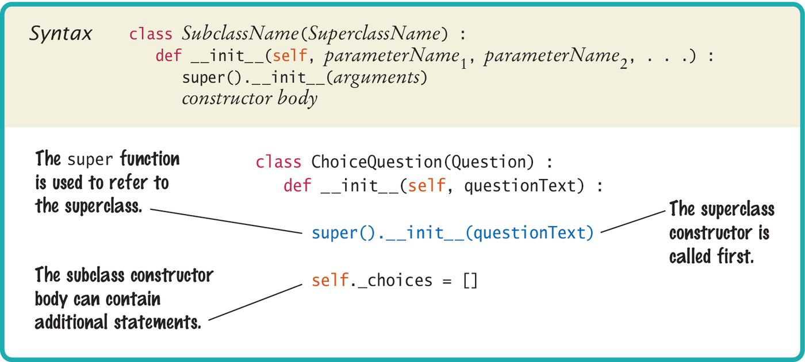
Calling the Superclass Constructor
If the superclass has input arguments, pass to it the all necessary data.
Pass input argument

Slide 19
Implementing New Methods
Implementing a new method for the subclass works the same way as implementing a method for any class.
ChoiceQuestion has the unique attribute _choices and needs to implement a new method for these choices.
The addChoice method has three parameters:
The required self parameter
The text string for the choice
A Boolean denoting whether it is the correct choice or not
def addChoice(self, choice, correct) :
self._choices.append(choice) # add choice to list # of possible choices
if correct :
# Convert the length of the list to a string.
choiceString = str(len(self._choices))
self.setAnswer(choiceString)

Slide 20
Overriding Superclass Methods
The ChoiceQuestion class needs a display method that overrides the display method of the Question class because it needs to display the choices.
The two methods named display are:
Question’s display
Displays the text of the question
ChoiceQuestion’s display
Displays the text of the question (same as Question’s display)
Displays the list of _choices in ChoiceQuestion
We can see that ChoiceQuestion can override the display method by calling Question’s display method, and then it only has to implement the display of the list of _choices.

Slide 21
Example: Overriding Superclass Method
class ChoiceQuestion(Question) :
. . .
def display(self) :
# Display the question text
super().display() # calling Question’s display
# Display the answer choices.
for i,choice in enumerate(self._choices) :
print("{:d}: {:s}".format(i, choice))
.

Slide 22
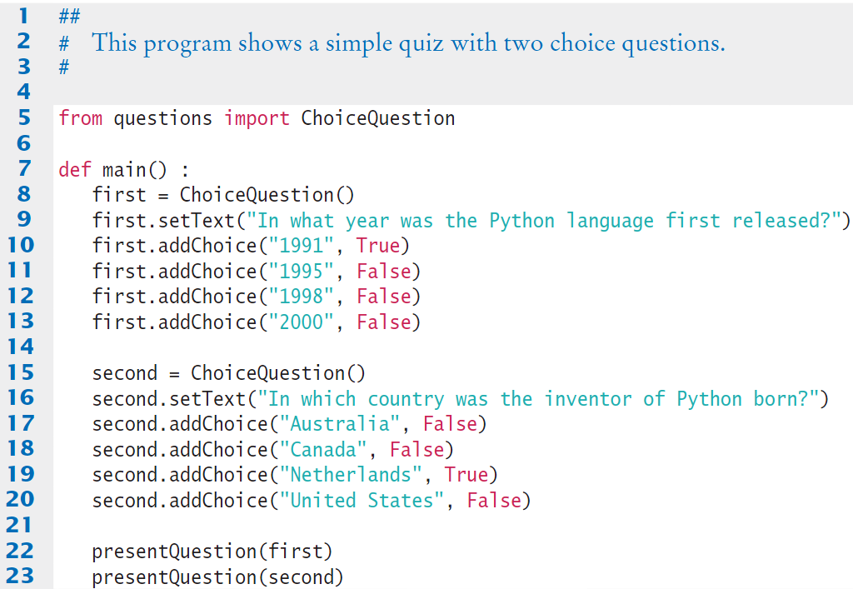
Example: Subclass Test Run
Creates two objects of the ChoiceQuestion class, uses new addChoice() method.
Calls presentQuestion() - next slide

Slide 23
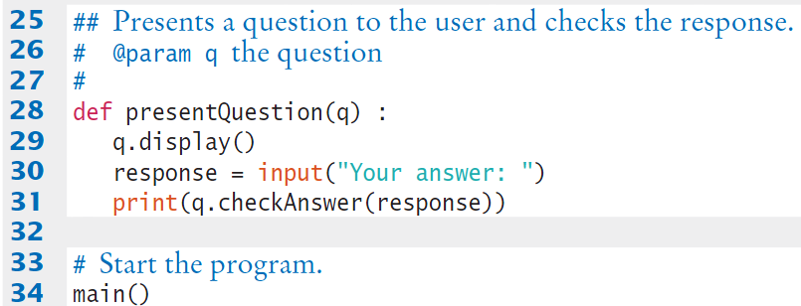
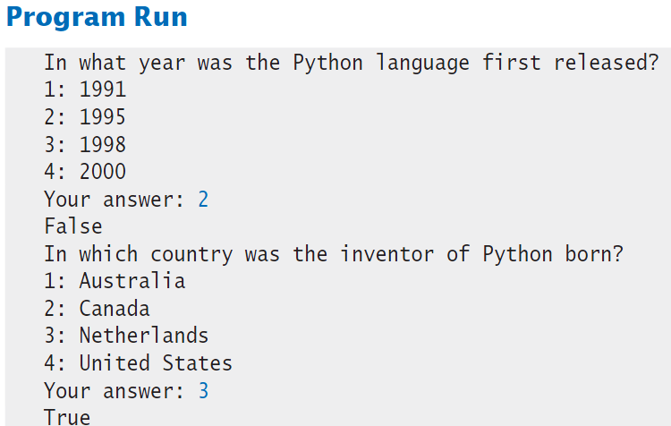
Example: Subclass Test Run
ChoiceQuestion’s display() runs

Slide 24
Polymorphism

Slide 25
Polymorphism (1)
In the previous subclass test run example, in main we pass two ChoiceQuestion objects to the presentQuestion method.
Can we write a general purpose presentQuestion method that can display any question type?
With polymorphism, this goal is very easy to realize!
When we have an inherited relationship between classes, we can write a function that works with superclass methods:
Both display and checkAnswer are methods of the Question superclass.
We can call presentQuestion and pass in an object of any subclass of Question.
def presentQuestion(q) :
q.display()
response = input("Your answer: ")
print(q.checkAnswer(response))

Slide 26
Polymorphism (2)
presentQuestion will simply call the display and checkAnswer methods of whatever type is passed.
If passed an object of the Question class: Question display will run.
If passed an object of the ChoiceQuestion class: ChoiceQuestion display will run.
If passed an object of the FreeResponseQuestion class: FreeResponseQuestion display will run.
The idea that the display and checkAnswer methods will behave differently even though it’s the same presentQuestion function that’s running is called polymorphism.
Polymorphism means multiple forms, and the presentQuestion function seems like it can take on different forms of the subclasses.

Slide 27
How Does Polymorphism Work?
Polymorphism works because method calls are determined by the type of the actual object during runtime, not at compile time.
This is called dynamic binding or late binding.
Polymorphism works only under these conditions:
The objects involved are part of an inheritance hierarchy.
The general function that uses polymorphism (such as the presentQuestion function) calls methods of the superclass only, not methods of any subclass.
The subclasses must override the methods of the superclass that are being called in the general function.
Polymorphism makes programs easily extensible. As our application requires more types of quiz questions, we simply create more subclasses with the display and checkAnswer methods. We don’t have to modify the presentQuestion method or any method that uses polymorphism.

Slide 28
Data Type Check

Slide 29
Type of an Object
We have learned that the type function returns the type of an object:
We can do the same with an object of a user-defined class:
The type function is useful to see the exact data type of an object, but it’s not as useful when the object is from a subclass of an inheritance hierarch.
Note that type(Q1) above returns the type ChoiceQuestion, which is correct.
But Q1 ‘is a’ Question type also, due to inheritance.
We cannot tell that Q1 is also type Question by using type.
var1 = 5
type(var1) # returns: <class 'int'>
Q1 = ChoiceQuestion()
type(Q1)
# returns: <class 'ChoiceQuestion'>

Slide 30
Checking Type of an Object
To check whether an object is a particular data type, Python provides the isinstance function.
isinstance accepts two input: the object reference and the type we want to check. It returns a boolean to indicate if there is a match.
For example, the function call: returns True
But isinstance can also be used to determine if an object is an instance of a superclass.
The function call: also returns True
isinstance(Q1, ChoiceQuestion)
isinstance(Q1, Question)

Slide 31
Use of isinstance (1)
A common use of the isinstance function is to verify that the arguments passed to a function or method are of the correct type.
Or, in the constructor of the Fraction class in the last module
def presentQuestion(q) :
if not isintance(q, Question) :
raise TypeError("The argument is not a Question
or one of its subclasses.")
# otherwise, work with the Question q ...
def _ _init_ _(self, numerator, denominator) :
if (not isinstance(numerator, int) or
not isinstance(denominator, int)) :
raise TypeError("The numerator and denominator
must be integers.")
# otherwise, work with the integer numerator and
# denominator ...

Slide 32
Use of isinstance (2)
For objects in an inheritance hierarchy, it is a bad idea to check for a specific subclass type in order to implement specific behavior:
if isinstance(q, ChoiceQuestion) :
# Do the task the ChoiceQuestion way
elif isinstance(q, FreeResponseQuestion) :
# Do the task the FreeResponseQuestion way
elif isinstance(q, NumericQuestion) : ...
Bad idea!
If a new subclass such as FillInQuestion is added, then we need to add another case to all places in the program that have a type test!
Instead we only need to check that an object is an instance of the superclass, and then we use polymorphism:
if isinstance(q, Question) : # if it’s any type of question
q.doTheTask() # polymorphism will cause the correct # subclass task to run

Slide 33
End of Chapter 10 Notes

